Slide 1
Intro to Web Design

Slide 2
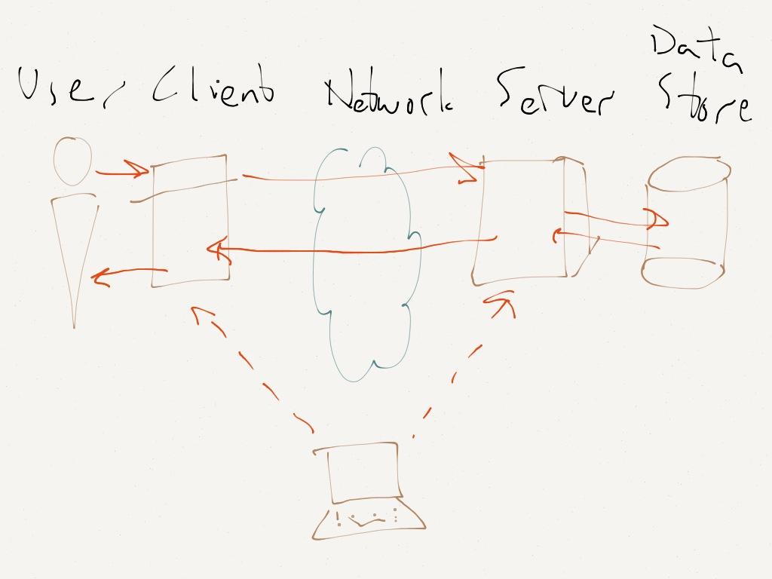
How does the Internet work?
User
Client
Network
Server
Data Store

Slide 3
HISTORY
http://www.internetsociety.org/internet/what-internet/history-internet/brief-history-internet

Slide 4
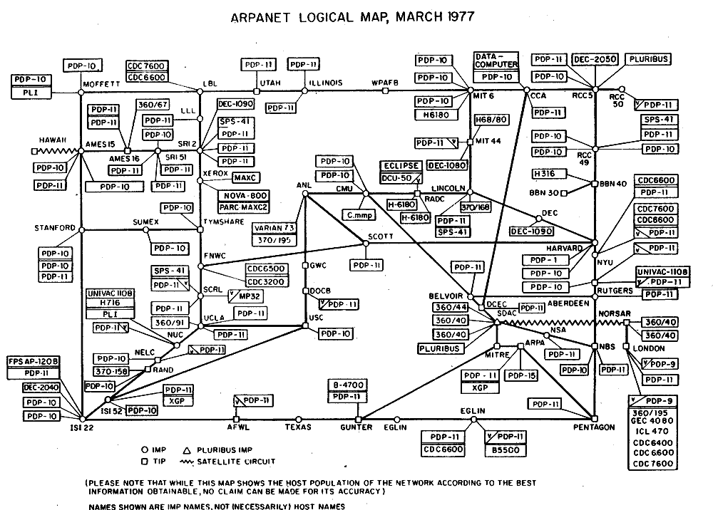
Arpanet
Lawrence G. Roberts designed ARPANET
ARPANET design was initially designed for 2.4 kbps but was upgraded to 50 kbps.

Slide 5
History
Ethernet technology, developed by Bob Metcalfe at Xerox PARC in 1973
Domain Name System (DNS) was invented by Paul Mockapetris of USC/ISI.
One of the more interesting challenges was the transition of the ARPANET host protocol from NCP to TCP/IP as of January 1, 1983

Slide 6
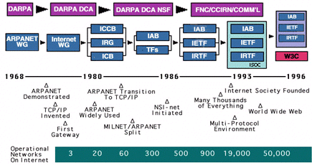

Slide 7
World Wide Web vs Internet
The World Wide Web (www, W3) is an information space where documents and other web resources are identified by URIs, interlinked by hypertext links, and can be accessed via the Internet
The Internet is a global system of interconnected computer networks that use the Internet protocol suite (TCP/IP) to link several billion devices worldwide.

Slide 8
TCP/IP
TCP/IP (Transmission Control Protocol/Internet Protocol) is the basic communication language or protocol of the Internet. It can also be used as a communications protocol in a private network (either an intranet or an extranet). When you are set up with direct access to the Internet, your computer is provided with a copy of the TCP/IP program just as every other computer that you may send messages to or get information from also has a copy of TCP/IP.

Slide 9
HTTP
Hyper Text Transfer Protocol
Hypertext is structured text that uses logical links (hyperlinks) between nodes containing text.
HTTP is the protocol to exchange or transfer hypertext.

Slide 10
HTML
HTML
HyperText Markup Language
is the standard markup language used to create web pages.

Slide 11
How does the internet work?
HTTP Requests
GET- retrieve data and should have no other effect
POST - request method is designed to request that a web server accept the data
PUT - Requests that the enclosed entity be stored under an existing resrource
DELETE -Deletes the specified resource

Slide 12
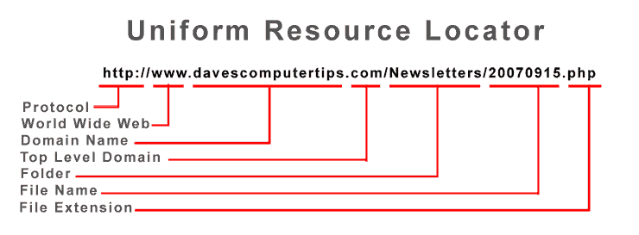
What is a url?
Uniform Resource Locator
http://74.125.224.18/

